Slide 1
Simple Interest

Slide 2
Repayment or final amount
Borrowed money or investment
Notes:
http://reiwa.com.au/uploadedImages/Public/Content/About_Us/News/photo-hand-holding-australian-money.jpg
https://www.google.com.au/imgres?imgurl=http%3A%2F%2Fpreviews.123rf.com%2Fimages%2Fkritchanut%2Fkritchanut1509%2Fkritchanut150900083%2F44894786-Hands-holding-money-Australian-dollar-AUD-banknotes-isolated-on-white-background-Stock-Photo.jpg&imgrefurl=http%3A%2F%2Fwww.123rf.com%2Fphoto_44894786_hands-holding-money-australian-dollar-aud-banknotes-isolated-on-white-background.html&docid=ifphiShd4KghhM&tbnid=UhebnYvSMjZxbM%3A&vet=1&w=1300&h=866&bih=676&biw=1424&ved=0ahUKEwjL07CAiO_RAhXIfrwKHdUYAp4QxiAIAygB&iact=c&ictx=1

Slide 3
Principal (Borrowed money or investment)
Interest
Repayment or final amount
Notes:
http://ewealthfinance.com/ewealthfinancecom/images/australian_money.jpg

Slide 4
Interest
Amount of money paid when one borrows money or invest
The amount of interest (I) paid is dependent on
The principal (P) – the initial amount of money which is borrowed or invested
The rate (R) at which the interest is charged
The time (T) for which the money is borrow.

Slide 5




SIMPLE Interest
I = PRT
I = interest
P = principal
R = rate (%)
T = time

Slide 6






How much interest would I have to pay if I borrow $4,000 for 6 years at an simple interest rate of 6% per annum?

Slide 7








Mark borrowed $3000 from his parents to buy a motorbike and he paid back a total of $3,600 after 5 years which includes simple interest on the loan. How much was the interest rate?

Slide 8








The interest paid on a loan was $2,000. Given that the interest rate is 5% and the money was borrowed over 10 years, what is the principal?

Slide 9
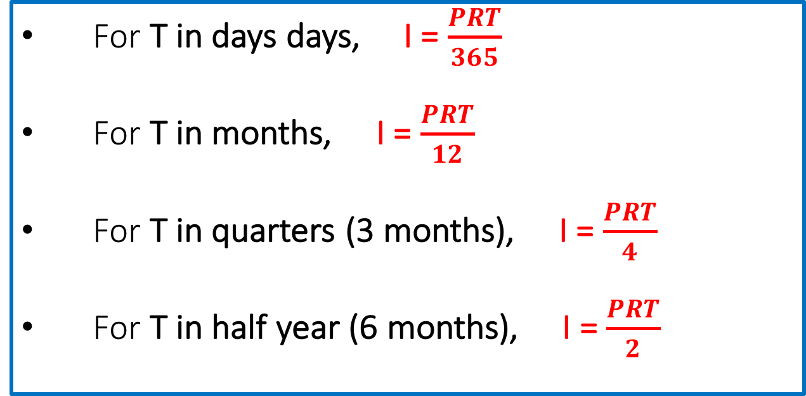
What if T is less than 1 year?
Given that the interest rate is always given per annum (per year), if T is less than one year, we can calculate the interest based on the duration.
For T in days days, I = $\frac{PRT}{365}$
For T in months, I = $\frac{PRT}{12}$
For T in quarters (3 months), I = $\frac{PRT}{4}$
For T in half year (6 months), I = $\frac{PRT}{2}$

Slide 10





How much interest is due after 75 days for an investment of $25 678 invested at 8% per annum?

Slide 11









How much is the interest rate per annum if I invested $88 000 in an account which yield an interest of $289 after 3 months? (Give your answers to 2 decimal places)

